Slide 1

DRUG REGULATORS

Slide 2


Agenda
Problem Statement
Approach
Key Priorities
Hierarchy Structure
Architectural Diagram
UML Diagram
Use Cases
Analysis
Summary

Slide 3

Problem statement
In the current global context, the pharmaceutical industry faces challenges in efficiently managing drug-related information across various entities. The proliferation of bio-chemical compounds necessitates a streamlined system for cataloging and tracking these compounds, linking them to specific diseases. Drug regulators require a robust platform to monitor and assess the safety and efficacy of new compounds. Healthcare enterprises need an integrated solution for managing medical inventory, ensuring timely access to critical drugs. In this complex ecosystem, effective communication among doctors, employees, and organizations is vital. The role-based access to sensitive information is crucial for maintaining confidentiality. As the world grapples with health crises, a comprehensive network that connects these elements is imperative for fostering collaboration, ensuring compliance, and ultimately advancing drug development and healthcare delivery. Developing a system that harmonizes these attributes can significantly enhance the efficiency and effectiveness of the drug development and healthcare ecosystem.

Slide 4
The proposed approach involves developing a centralized platform that integrates bio-chemical compound data, disease information, and drug-related details. This platform should facilitate seamless communication between doctors, employees, and organizations, incorporating a role-based access system to ensure data security. Drug regulators can benefit from a dedicated module for monitoring and evaluating the safety and efficacy of drug compounds. Additionally, the system should include features for managing medical inventory within healthcare enterprises. A robust network infrastructure will underpin this solution, fostering collaboration, compliance, and information exchange, thereby advancing drug development and optimizing healthcare delivery in response to the evolving global health landscape.
APPROACH

Slide 5

KEY PRIORITIES
The primary focus should be on developing an integrated platform for seamless collaboration among researchers, healthcare professionals, and regulators.
Emphasis should be placed on secure information exchange, role-based access controls, and efficient medical inventory management. Incorporating a dedicated module for patients to participate in clinical testing ensures real-world efficacy data.
Strengthening the network infrastructure will enhance communication and compliance across the drug development lifecycle, fostering a holistic approach to advancing medical research and patient-centric healthcare.

Slide 6
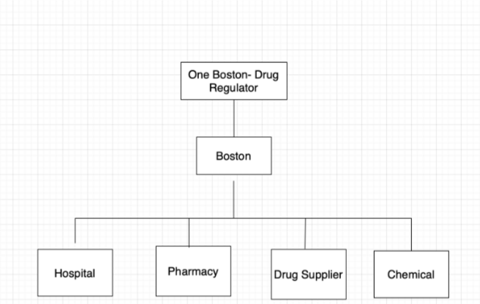
HIERARCHY STRUCTURE
Sample Footer Text

Slide 7
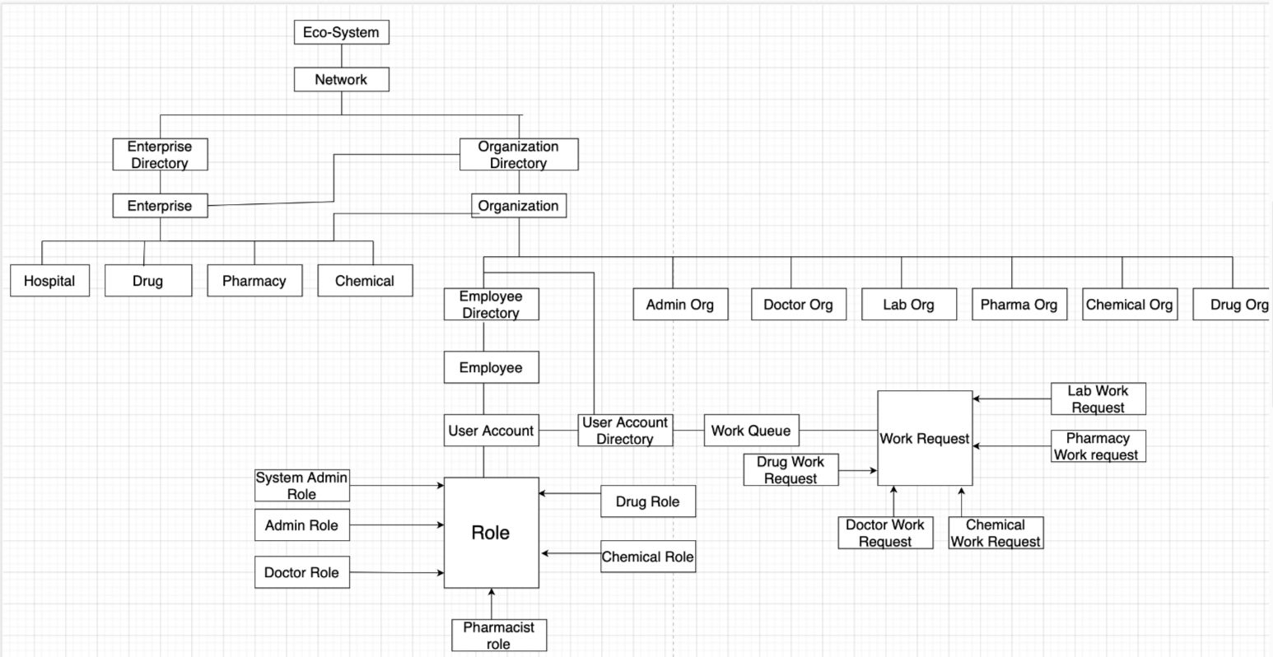
ARCHITECTURAL DIAGRAM

Slide 8
UML DIAGRAM
Caption

Slide 9
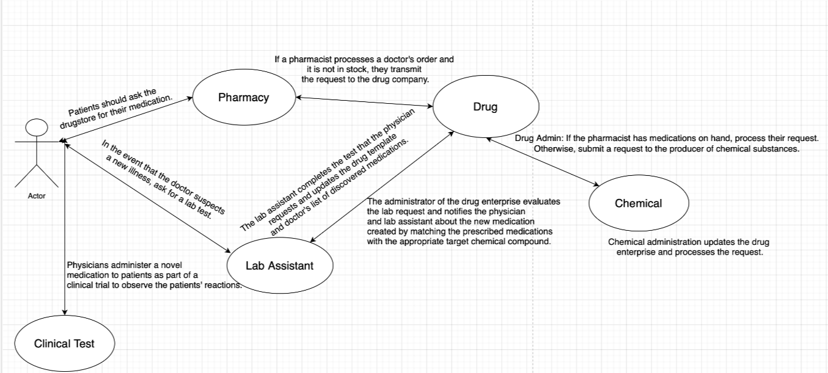
USE CASES

Slide 10

ANALYSIS

Slide 11
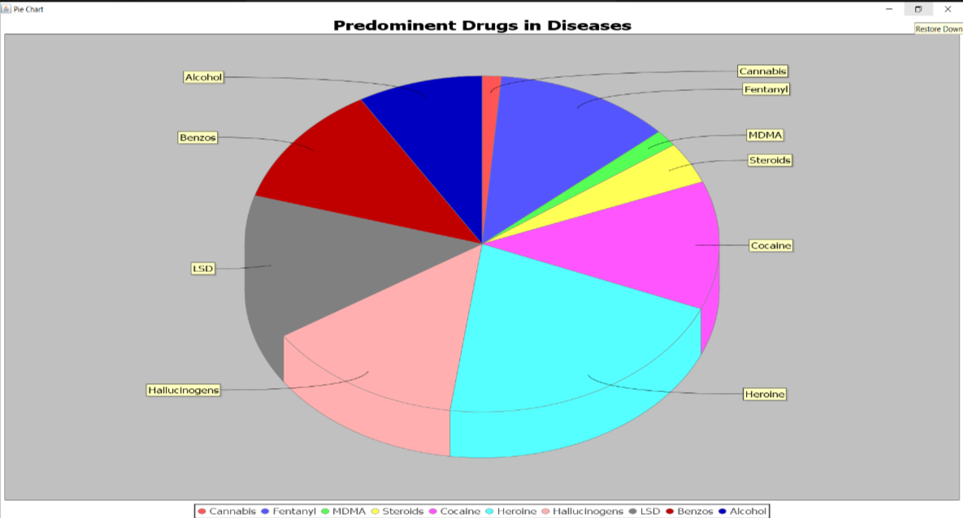

Slide 12
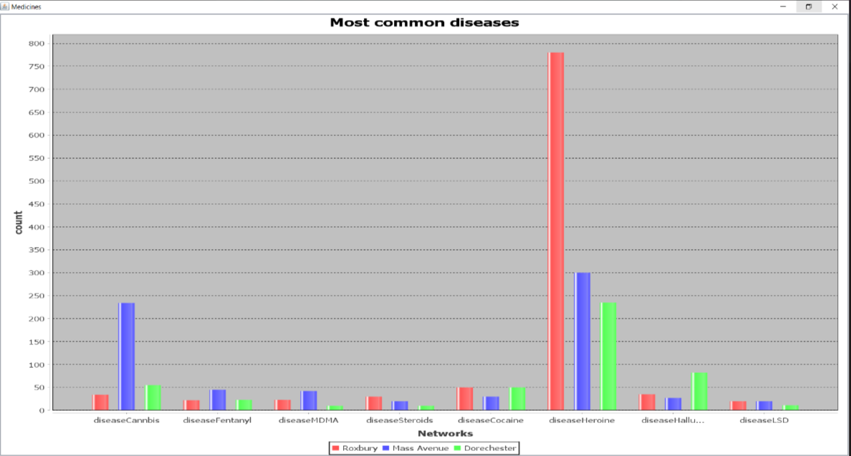

Slide 13
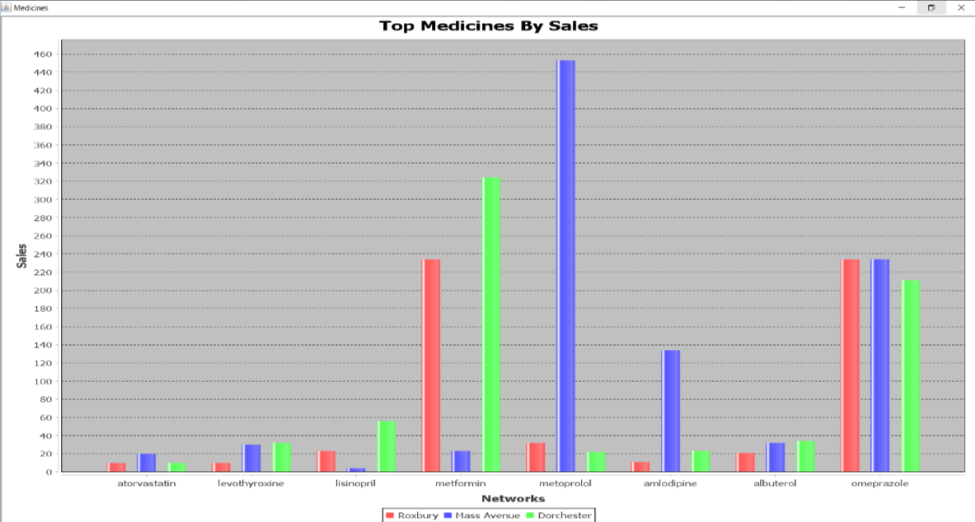

Slide 14

Summary
The focus is on developing an integrated platform that facilitates collaboration among researchers, healthcare professionals, and regulators. Key priorities include secure information exchange, role-based access controls, and efficient medical inventory management. A dedicated module for patient participation in clinical testing ensures real-world efficacy data. Strengthening the network infrastructure enhances communication and compliance across the drug development lifecycle, fostering a holistic approach to advancing medical research and patient-centric healthcare.

Slide 15

Thank you
PRESENTED BY:
Nisha Sirdesai (002810901) Bhagya Trivedi (002765362)
Sohni Rais (002830773)
Sanat Popli (002201005)

